Slide 1
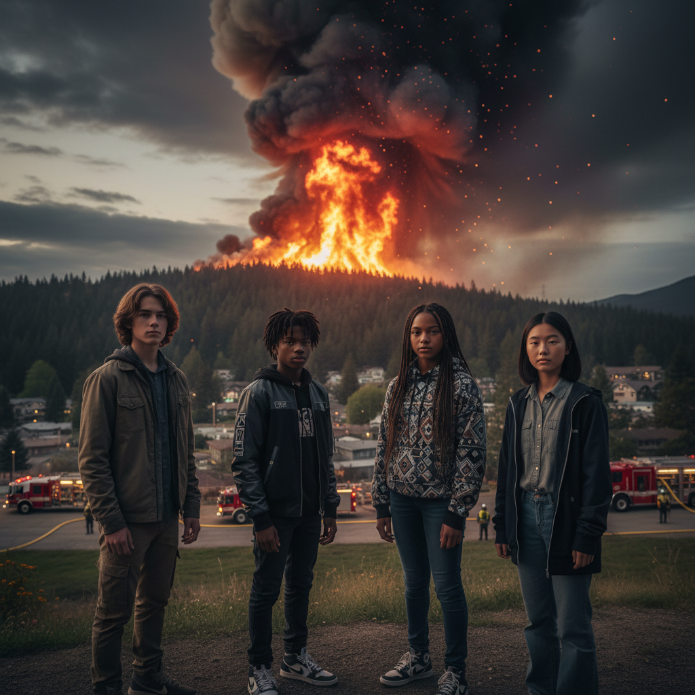
ModelIt!
Student Lesson
The Wildfire Feedback Loop
Modeling How Fire, Climate, and Ecosystems Create a Self-Reinforcing Cycle
NGSS: HS-ESS3-3, HS-LS2-6
9th Grade — Level 1: Foundations
1/9

Slide 2
What You Will Learn Today
Learning Goals
* Model the positive feedback loop where wildfire destroys vegetation, reduces soil moisture, and creates conditions for more intense future fires
* Explain how fuel load, fire intensity, soil moisture, wind speed, and vegetation recovery interact in wildfire dynamics
* Predict how climate change is accelerating the wildfire feedback cycle by lengthening fire seasons and increasing fuel dryness
* Analyze why fire suppression policies have paradoxically made wildfires more dangerous
Key Vocabulary
Fuel Load
The total amount of combustible material — dead leaves, fallen branches, dry grass, bark, and even living vegetation — available to burn in a given area, measured in tons per hectare
Fire Intensity
The rate of heat energy released by a wildfire, measured in kilowatts per meter of fire front — low-intensity fires clear underbrush, while high-intensity crown fires destroy entire ecosystems
Soil Moisture
The amount of water held in the soil, which affects both vegetation health and fire behavior — dry soil means stressed vegetation with higher fuel ignitability and faster fire spread
Positive Feedback Loop
A self-reinforcing cycle where the output of a system amplifies the input — in wildfire: fire reduces vegetation → less vegetation means drier soil → drier soil makes more fuel flammable → next fire is more intense
2/9

Slide 3
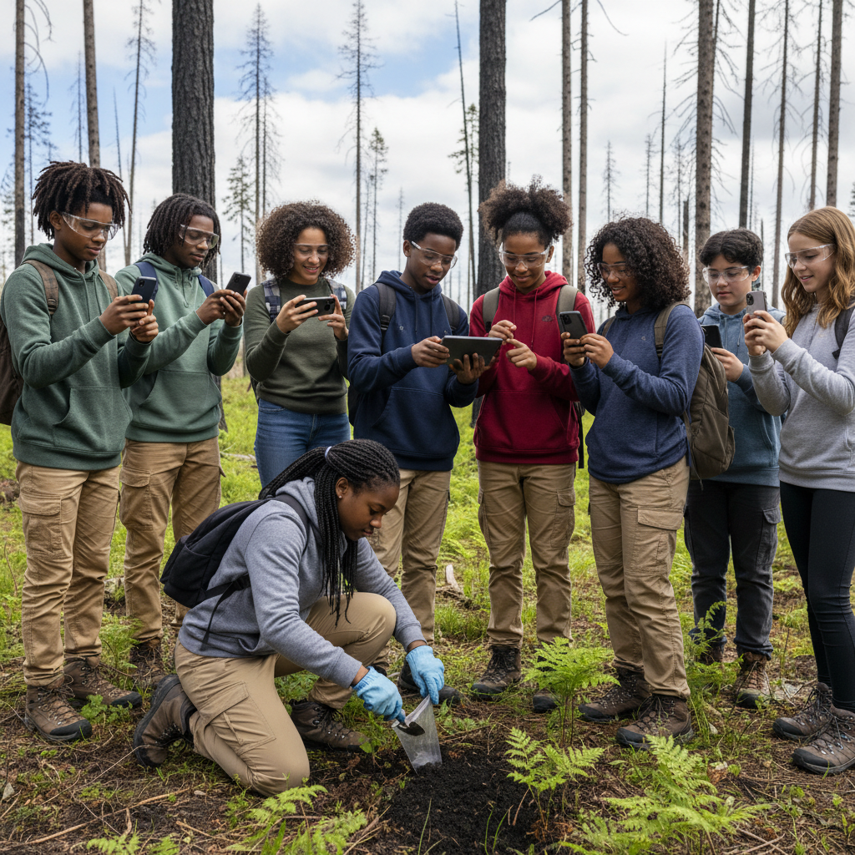
The Big Question
Why are wildfires getting bigger, hotter, and harder to stop — and is the cycle feeding itself?
Modeling How Fire, Climate, and Ecosystems Create a Self-Reinforcing Cycle. Today we'll build a MODEL to discover the answer!
3/9

Slide 4

Today We Will Build a Model!
A model helps us understand complex systems!
1. LOCATE
Identify the COMPONENTS (parts) of the system
2. ESTABLISH
Connect them with RELATIONSHIPS (+ or -)
3. VISUALIZE
Build your model in ModelIt!
4. EVALUATE
Run SIMULATIONS to test scenarios
5. REVISE
Improve your model based on evidence
4/9

Slide 5

Activity 1: Sort the Components
Sort these components into EXTERNAL (inputs from outside) and INTERNAL (inside the system):
Your Components:
* Wind Speed
* Fuel Load
* Fire Intensity
* Soil Moisture
* Vegetation Recovery
Think: Which components can we control? Which happen on their own?
5/9

Slide 6
Activity 2: Connect with Arrows
Draw arrows to show HOW components affect each other:
(+) POSITIVE Relationship
When one goes UP, the other goes UP too
(-) NEGATIVE Relationship
When one goes UP, the other goes DOWN
Think About It:
After a major wildfire burns through a forest, how does the destruction affect Soil Moisture, Fuel Load for the next fire, and Vegetation Recovery? Where does the feedback loop either stabilize or spiral out of control?
6/9

Slide 7
Activity 3: Run the Simulation!
Test these scenarios in ModelIt!
Low-Intensity Fire, Healthy Forest
Set Wind Speed to low with moderate Fuel Load — observe how a mild fire clears underbrush without destroying the ecosystem
Extreme Fire, Drought Conditions
Set Wind Speed to high with maximum Fuel Load and low Soil Moisture — observe the catastrophic fire and its impact on future fire conditions
Post-Fire Recovery
After a major fire, track Vegetation Recovery and Soil Moisture over time — observe whether the ecosystem recovers or enters the destructive feedback loop
Watch the activity graphs change!
[ModelIt Platform Screenshot - Simulation Results Graph]
7/9

Slide 8
What Did We Discover?
Our Model Showed Us:
* Low-intensity fires are natural and beneficial — they clear fuel buildup, recycle nutrients, and promote biodiversity, keeping forests healthy and reducing the risk of catastrophic fires
* A positive feedback loop exists: intense fire destroys vegetation → less vegetation means less water retention → drier soil creates drier fuel → next fire burns hotter → even more vegetation destroyed
* Decades of fire suppression have created unnaturally high fuel loads in many forests, turning what should be low-intensity surface fires into catastrophic crown fires that destroy entire ecosystems
* Climate change is accelerating the feedback loop by raising temperatures, extending drought seasons, and reducing soil moisture — creating fire conditions that exceed the ecosystem's ability to recover
Answer: Wildfires are getting bigger, hotter, and harder to stop because of a self-reinforcing positive feedback loop accelerated by climate change and a century of fire suppression. When a catastrophic fire burns through a forest, it destroys the vegetation that holds soil moisture. Without vegetation, the soil dries out faster, which stresses any regrowing plants and makes dead material more flammable. The next fire encounters drier, more abundant fuel and burns even hotter. Meanwhile, decades of fire suppression have allowed fuel to accumulate to unnaturally high levels, and climate change has made droughts longer and more intense. The system is feeding itself — each fire creates the conditions for a worse one.
8/9

Slide 9

STEM Challenge: Design a Community Wildfire Resilience Plan
YOUR ENGINEERING MISSION
Design a comprehensive wildfire management plan for a community in the wildland-urban interface that breaks the feedback loop through prevention, preparation, and ecosystem restoration.
The Challenge:
A mountain community of 15,000 people borders a national forest that hasn't experienced a major fire in 80 years. Fuel loads are at record levels, drought conditions are worsening, and the forest is surrounded by new housing developments. The community has hired your team to design a wildfire resilience plan that addresses both immediate safety and long-term ecosystem health. Your plan must balance fire prevention with the ecological need for fire.
Think Like an Engineer:
* How would you use prescribed burns and fuel reduction to break the feedback loop before a catastrophic fire occurs?
* What design features would you recommend for homes and buildings in the wildland-urban interface?
* How do you balance the ecological benefits of natural fire with the need to protect human lives and property?
REAL CAREER CONNECTION: Wildfire Scientists study fire behavior, ecology, and management strategies using computational models and field research, earning $55,000–$110,000/year. Fire Ecologists study how fire shapes ecosystems and design prescribed burn programs, earning $50,000–$100,000/year. Urban Planners specializing in wildfire resilience design communities that can coexist with fire-prone landscapes, earning $60,000–$120,000/year. The skills you're using TODAY are the same ones they use on the job!
9/9

